Slide 1

SHEBUILDS 2025
NyayaSahaya
न्यायसहाय — Justice Helper
AI-powered legal guidance, built for every woman in India

Slide 2


THE PROBLEM
Justice Is Out of Reach for Most Women
In India, legal help isn't just expensive — it's invisible to millions of women who need it most.
Financial Barrier
Legal consultation fees are unaffordable for a vast majority of women, especially in rural and semi-urban India.
Geographic Barrier
Lawyers and legal aid centers are concentrated in cities — over 70% of India's population lives in areas with little to no legal access.
Awareness Barrier
Most victims don't know which laws protect them before they can consult a lawyer. Legal language is dense and intimidating.
Only 1 in 10 women who experience domestic violence in India ever seek help from legal or police sources. The justice gap is not a courtroom problem — it's an access problem.

Slide 3
SOLUTION
What is NyayaSahaya?
NyayaSahaya (न्यायसहाय) means "Justice Helper" — an AI-powered web platform that delivers structured legal guidance tailored specifically to women in India.
Upload Your Case
Multi-Expert Analysis
Describe your situation in your own words or upload a document
6 specialist AI agents analyze your case from every angle
Understand Your Rights
Take Action
Get plain-language insights on laws that protect you
Draft documents, find legal aid, and move forward with confidence
8 Powerful Modules
Case Analysis Dashboard
Deploy Expert Agents ⭐
Document Translator
AI Chat
Legal Draft Generator
Know Your Rights
Legal Myths Buster
Legal Aid Directory

Slide 4


The Multi-Agent Pipeline
Legal cases are multi-dimensional. A financial constraint, a psychological trauma, and a human rights violation can all exist in the same case. One expert isn't enough — so we built six.
⚖️ Legal Agent
💰 Financial Agent
🧠 Psychology Agent
Applicable statutes & IPC sections
Compensation & economic remedies
Emotional impact & mental health resources
🤝 Social Agent
🌍 Human Rights Agent
📋 Procedural Agent
Community support & social dynamics
Step-by-step legal process guidance
International & constitutional rights frameworks
Why 6 agents? Each brings a different lens. Together, they debate, cross-validate, and synthesize insights — reducing blind spots that a single AI (or lawyer) might miss.

Slide 5

HOW IT WORKS
The 5-Stage Agent Flow
Case Input
Agent Analysis
Knowledge Graph
Agent Debate
The Agent Debate stage is what sets NyayaSahaya apart — agents actively challenge each other's conclusions, flagging contradictions and building consensus only where the evidence supports it. This cross-validation dramatically reduces LLM hallucination risk.
Knowledge Graph — maps relationships between legal provisions, precedents, and case facts as interconnected nodes
Conflict Edges — disagreements between agents are surfaced explicitly, not hidden
Agreement Edges — where agents converge, confidence in the recommendation increases

Slide 6
FEATURES
Case Analysis Dashboard & Document Translator
📊 Case Analysis Dashboard
🌐 Document Translator
A structured 8-tab breakdown that turns a raw case description into actionable intelligence:
Legal documents shouldn't be locked behind language barriers.
Upload — case intake & document parsing
Overview — plain-language summary
Risk Scoring — severity & urgency assessment
Case Strength — evidentiary analysis
Precedents — relevant court judgments
Timeline — court-specific process timelines
Legal Help — NALSA integration & aid referrals
Evidence — what to collect & preserve
12 Indian Languages
Plain-Language Summaries
Hindi, Tamil, Telugu, Bengali, Marathi, Gujarati, and more — making legal content accessible to any Indian woman
Upload a PDF legal notice or FIR — get a clear, jargon-free explanation in your language
Legal Term Preservation
Critical terms like Section 498A or POCSO are preserved intact — never mistranslated

Slide 7
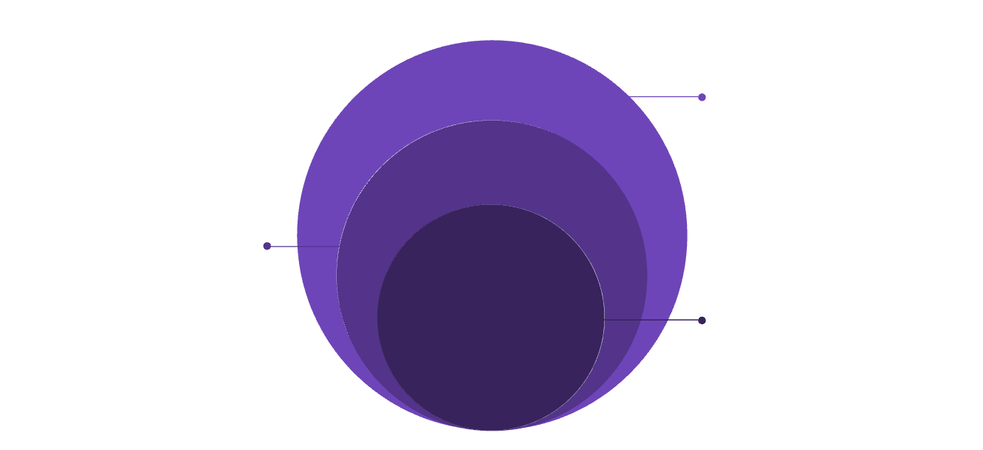

TECHNICAL
Tech Stack & Architecture
Stack
Architecture Flow
Groq AI
Frontend
LLaMA 3.3 70B, 6 agent calls, 8B fallback
Vite + Vanilla JS — fast, lightweight, no framework overhead
Backend
Node.js + Express, agent orchestration, SSE
Backend
Frontend
Node.js + Express + SSE for real-time streaming of agent results
Vite + Vanilla JS, UI, SSE listener
AI Layer
Results stream back to the user in real-time via Server-Sent Events (SSE) — each agent's output appears as it completes, not after all six finish.
Groq Cloud + LLaMA 3.3 70B (with 8B fallback for token limits)
Why Groq? 10–20× faster inference than standard GPU providers, with a free tier that makes this project viable at zero infrastructure cost.

Slide 8
TRUST & HONESTY
Privacy, Security & Known Limitations
🔒 Privacy by Design
No Data Persistence
No Server Storage
Rate Limiting & CORS
Case data lives in browser memory only — never written to disk or database
Zero user data stored server-side. The backend routes — it never retains.
API abuse prevention and strict origin restrictions protect the platform
⚠️ Limitations (and how we handle them)
Groq token limits → Automatic fallback to LLaMA 3.3 8B model — seamless to the user
LLM hallucination risk → 6 agents cross-validate each other; disagreements are surfaced, not hidden
No real lawyer database → Recommends verified platforms (NALSA, DLSA, eSewa Kendras) instead

Slide 9
WHAT'S NEXT
Roadmap & Impact Vision
🗺️ Future Roadmap
🌟 Who This Helps
Any Indian woman — rural or urban, literate or not — who faces a legal crisis without access to a lawyer.
Voice Input
Scale Potential
Accessibility for low-literacy users — speak your case, don't type it
12 Indian languages — reaches across linguistic barriers
Any device with a browser — smartphone is enough
Zero cost to the user — free at point of need
WhatsApp Bot
Reach women where they already are — no app download required
Built for SheBuilds — empowering women with accessible legal intelligence.
User Auth + Case History
Secure login and saved case progress for continuity
Real Lawyer Directory
Vetted, affordable legal professionals — searchable by region & language
Multi-Language UI
Full interface localization — not just document translation

Slide 10


THANK YOU
Try NyayaSahaya
Questions, feedback, or want to see a live demo? We'd love to walk you through it.
GitHub
The Team
Source code, documentation, and setup guide — open source & open for contributions
Built with purpose for the SheBuilds Hackathon — Justice shouldn't be a privilege.
NyayaSahaya — न्यायसहाय — Justice Helper. Because every woman deserves to know her rights.

